Slide 1

Department of Information Technology
A.P. Shah Institute of Technology
G.B.Road,Kasarvadavli, Thane(W), Mumbai-400615
UNIVERSITY OF MUMBAI
Academic Year 2019-2020

Slide 2
A Project Report on
ParkMania : The Parking Management System
Submitted in partial fulfillment of the degree of
Bachelor of Engineering(Sem-8)
in
INFORMATION TECHNOLOGY
By
Srinivas Vishwanath(16104010) Saurabh Sharma(16104001)
Under the Guidance of
Prof. Kiran Deshpande Prof. Yamini Patil Prof. Sneha Kanchan

Slide 3
1.Project Conception and Initiation

Slide 4
1.1 Abstract
Due to the increasing population in urban cities, there is an exponential rise in the number of vehicles which is leading to major problems leading to poor traffic management and congestion. Another major problem face by the vehicle owners is the availability of parking space. The idea of Smart Cities is slowly gaining pace with the ever increasing technologies. It can be deployed in various kinds of environments to monitor and collect information. The vehicle owner will be able to reserve a slot for his/her vehicle from anywhere and will be provided with a QR code which will be scanned on the entry of the parking area. Also the problem of finding a vacant parking slot in a large parking will be taken care of by our system as the vehicle will be guided to the particular slot by the app itself.

Slide 5
1.2 Objectives
Faster reservation of a parking slot anytime and from anywhere.
Providing information about nearby parking slots that are vacant.
Online payment portal integration making it easier for the vehicle owners to complete the transaction.
Graph Analysis depicting the typical peak hours when the parking area is most/least occupied.
QR code for verifying the user who has booked/reserved the parking slot.
Payment calculation based on time for which the vehicle was parked.
Storage of the vehicle and owner details in the backend.

Slide 6
1.3 Literature Review
Paper Title: Low Cost Smart Parking System for Smart Cities. Authors: D.Vakula and Yeshwanth Krishna Kolli Publication Details: 2017 IEEE Xplore Compliant(ICISS 2017)
Findings: From this system we found out how ultrsonic sensors can be integrated with Raspberry Pi and Node MCU and how the information from Rasberry Pi can be transmitted to the front end GUI and back end database.
Advantages: -
It provides GUI so that you can see the available slots.
Disadvantages: -
No solution if parking slots are full.
Does not display nearby parking area within the vicinity of the original parking area.

Slide 7
Paper Title: Advanced car parking system usingarduino. Authors: Hemant Chaudhary, Prateek Bansal, Dr.B. Valarmathi Publication Details: 2017 International Conference On Advanced Computing and Communication Systems(ICASS-2017)
Findings: From this system, we found out how security and authorization of every vehicle owner is achieved using RFID tag. It also explains how to display the information of vacant parking slots on a LCD.
Advantages: -
Every user gets an authorization RFID card which is verified and thereby only authentic car owners are allowed and only then will the gate open.
Security is thereby taken care of.
Disadvantages: -
No GUI provided to see the available slots.
Since arduino was used external wifi module was required to transmit data to application

Slide 8
Paper Title: Automatic car parking system with visual indicator along withiot. Authors: Sarthak Mendiratta, Debopam Dey, Deepika Rani Sona. Publication Publication Details: 2017 International Conference on Micro-electronic devices.
Findings: From this system, we learn how Wireless Sensor Network Technology is used to show if a parking slot is vacant or not usingLEDs.
Advantages: -
GUI is provided which helps the user to know before hand which parking slot is empty.
Disadvantages: -
No online payment feature included.
Nearby parking areas are not displayed in case the parking is full.

Slide 9
Paper Title: IoT based vehicle parking manager. Authors: J Desai, A Bhanje, S Biradar, D Fernandes Publication Details: 2017 7th International Conference on Cloud Computing, Data Science & Engineering - Confluence.
Findings: From this paper we have understood how Raspberry Pi Camera Module is used to scan the QR code along with the ultrasonic sensor to detect the presence of a vehicle and verification of the user. Servo Motor was used to control the opening and closing of the gate at the entrance after verification.
Advantages: -
Raspberry Pi Camera module is used which records high definition photographs to scan QR codes.
Only authenticated users can enter the parking area by scanning the QR code, hence, security was maintained.
LCD for displaying the car number and the booked slots.
Disadvantages: -
This system fails to direct a vehicle to the vacant parking slot through GUI.
Therefore in bigger parking areas, this system may have limitations

Slide 10
Paper Title: IoT based smart parking system. Authors: Khanna, A., & Anand, R Publication Details: 2016 International Conference on Internet of Things and Applications (IOTA).
Findings: In this paper we have learnt how we can integrated the cloud with the system to store the vehicle details. Also, parking cost based on time is calculated and time out notifications are sent to user using android application which keeps them updated.
Advantages: -
Cloud is used for storing large amounts of user data.
In case of system failure, it provides quick recovery and backup services.
Disadvantages: -
No provision provided for offline booking of parking slots.

Slide 11
1.4 Problem Definition
As the city is developing and with increase in population, people are finding it difficult to park their vehicles.
In some parking place there is no safety for the vehicle.
There is a chance of theft or vehicles may get damaged.
People waste their time to search vehicle parking place.
To solve these problems Online Vehicle Parking Monitoring is used.
The basic concept behind this project is that it reduces the time of the customer by providing proper packing facility.
Any customer can book the available parking slot with particular time.
This provides security to the customer.

Slide 12
1.5 Scope
We focus on implementing our system at the college level. Following will be the benefits for the students/faculty members:
Ease for finding vacant parking slots.
Incase the parking area is full, our system will list out and help users get information about nearby parking areas.
The user will also be able to book a slot in the nearest parking area.
Separate spaces for 2-wheeler and 4-wheeler parking.
Security is provided as user details are stored in the backend.
Availability of a vehicle in a particular slot with the help of sensors.

Slide 13
1.6 Technology stack
Android Studio – For designing and building the application.
Firebase – For backend storage of live user details and parking details.
Cloud Messaging (Firebase) – For sending push notifications alerting the user if they have exceeded the time limit.
QR Code – For marking the presence/absence of the vehicle.
Arduino – For programming the hardware.

Slide 14
1.7 Benefits for environment & Society
Following are the benefits or contribution of our application:
With the help of this application the user can prebook a parking slot and not worry about finding a parking area.
If the main parking area is fully packed, the user can look fornearby parking areas in vicinity to the main area, this therefore avoids the chaos and solves the problem of people parking their vehicles anywhere.

Slide 15
2. Project Design

Slide 16
2.1 Proposed System
Our proposed system works in the following way:
1. Vehicle Owner books/reserves the parking slot using the mobile application by selecting the date and time.
2. In turn the user will get a QR code which will be used for verification later.
3. At the entrance, the user verifies the identity using the QR code and is assigned a particular parking slot based on the type of vehicle (car/bike).
4. An additional feature our system provides is that it displays the nearby parking areas. This feature is included because if the current parking area is full, the user can check for the nearby area where the vehicle can be parked.
5. The application displays booked, prebooked and occupied slots with the help of GUI.
6. Additional amount is imposed if a user extends the parking time.
7. An alert notification for extending the parking time slot is sent 15 minutes prior to the end of the booking time.

Slide 17
2.2 Design(Flow Of Modules)
The design of our application consists of the following:
1. Login and sign up screen for identifying a user uniquely.
2. On successful login, the user is guided to the home page where user get three options where he can book a slot, check for nearby areas and book a slot in nearby area.
3. On selecting book a slot, the next page will give you to the option to select the type of vehicle i.e. is either two wheeler or four wheeler and the zone.
4. The available slot will be displayed using green and the occupied slots are displayed by red.
5. When the vacant slot is selected you need to provide the necessary time and date.
6. A QR code can be generated which will be scanned during the entrance for the unique identity of the user.
7. On selecting nearby parking areas, a map displaying the nearby areas is selected.
8. On clicking ‘Book nearest parking area’ you can book a parking slot in a area which is in vicinity to the main parking area.

Slide 18
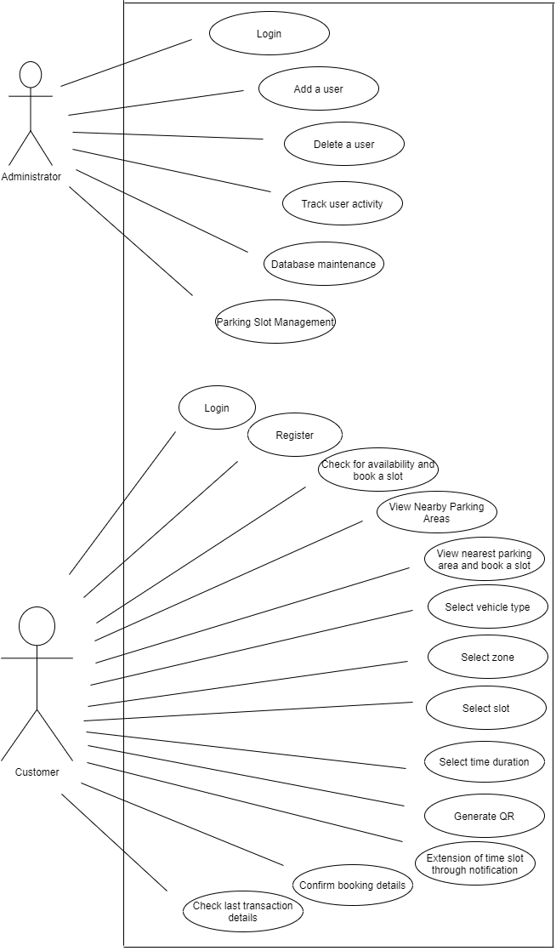
2.3 Description Of Use Case
Our use case consists of two major entities that interact with the major modules of the application.
The first one is the customer who can sign up/login, book a slot check for nearby areas, book a slot in nearby parking area.
The second is the administrator who has an access to access the backend database enter and manage slots, accounts and user activity.

Slide 19
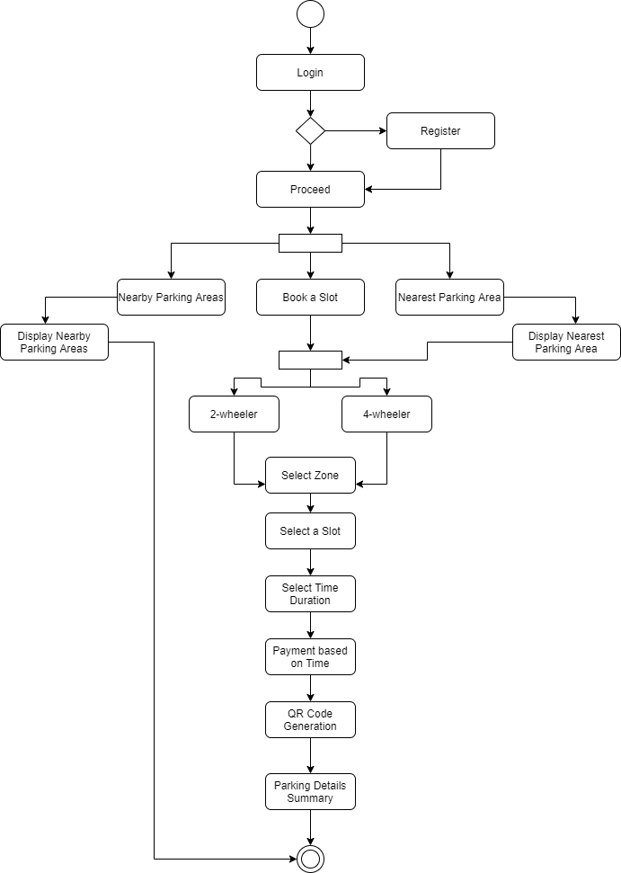
2.4 Activity diagram
Activity Diagram begins with the login or signup page after which the user can either book a slot or check for nearby parking areas.
Further there are zones for 2 wheeler and 4 wheeler parking which the user should select providing the necessary date and time for booking the slot.
Accordingly the price will be calculated and displayed on to the user
The user can generate a QR code which contains the booking details of that particular user and this QR code will be scanned at the entrance of the parking area.

Slide 20
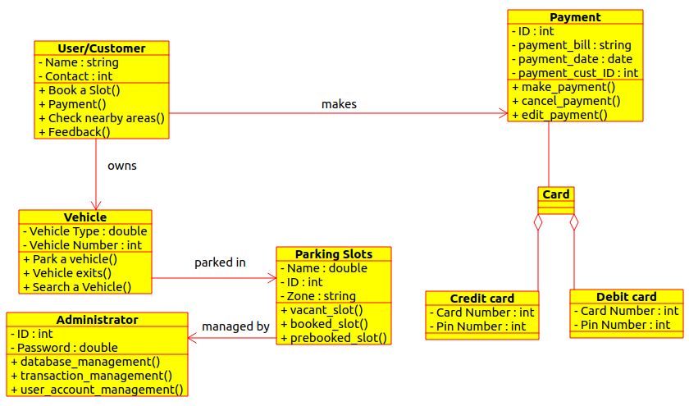
2.5 Class Diagram
The class diagram alongside displays various modules of our application interacting with each other.
As it can be seen, the class customer is associated to payment class as customer makes the payment.
Similarly, admin monitors and manages the parking slots, the vehicle is parked in these slots.
Payment is further divided into Credit card and Debit card payment.

Slide 21
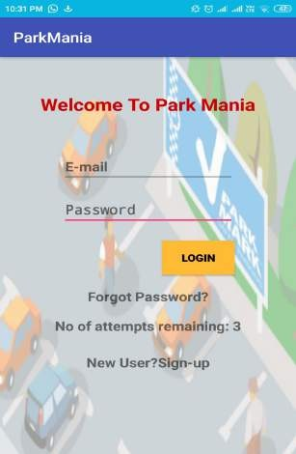
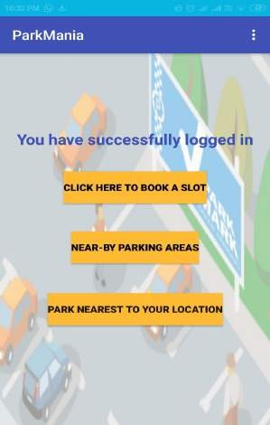
2.6 Module-1 (Login/Register)
For the particular user to sign in to his account to make the booking.
If the user is not registered, he/she will have to get create a new login and then log in.
If suppose the user forgets the password he can click on the forget password option which sends a link to the user’s email to reset the password.

Slide 22
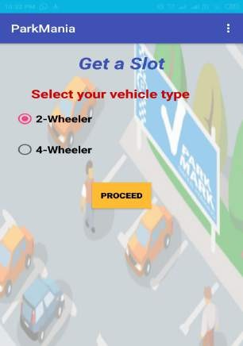
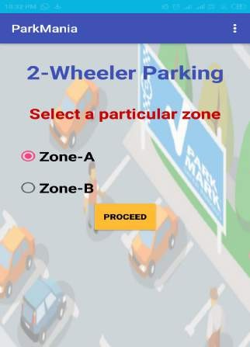
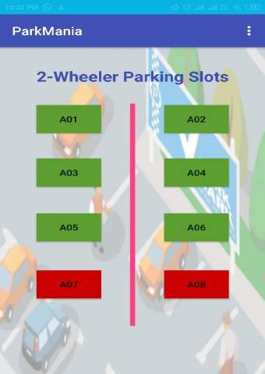
Module-2(Booking a Slot)
On clicking on ‘Book a Slot’ option, the user will be asked to select the type of vehicle owned by him (i.e. 2 wheeler or 4 wheeler).
Further there will be zones classified based on the type of vehicle (A,B,C,D)
After which the user can select the available slots displayed in green.
Already booked and occupied slots will be displayed and red and will have no action when tapped/clicked upon.

Slide 23
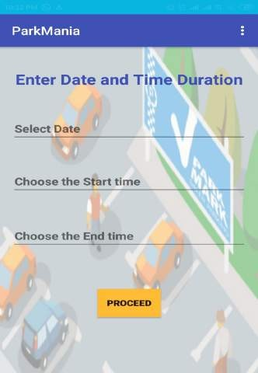
Module-3(Date and Time)
After the selection of a slot, the user is asked to provide the day and the time for which the vehicle needs to be parked.
On the basis of the time, the payment calculation is done and the amount that is to be paid is generated.
The above details are simultaneously stored on the backend database.

Slide 24
Module-4(Payment Gateway)
The necessary payment calculation is done and the customer is further guided to make the payment.
The integration of payment gateway helps the customer to do so electronically.
The payment can be made using PayTm, credit or debit cards.

Slide 25
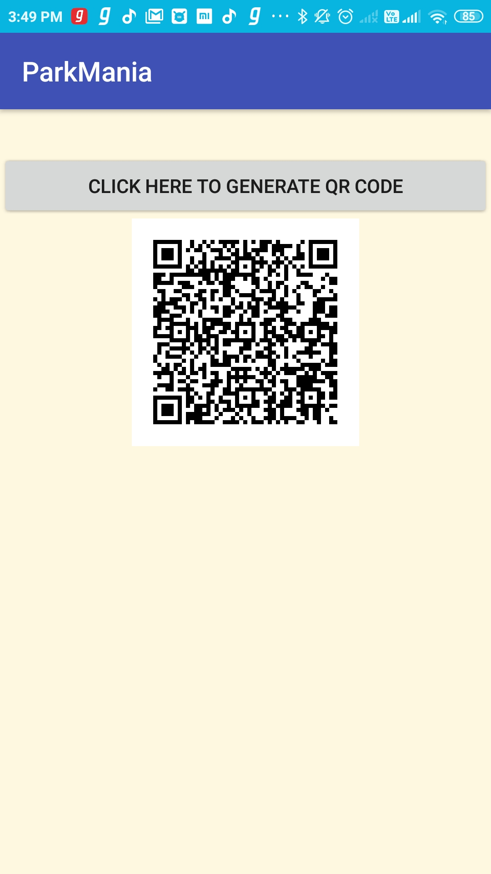
Module-5(QR Generation)
The QR can be generated by the user for future verification.
This contains all the parking details of the user which he can confirm for himself.
At the entrance of the parking area the QR code will be scanned for verifying the user.

Slide 26
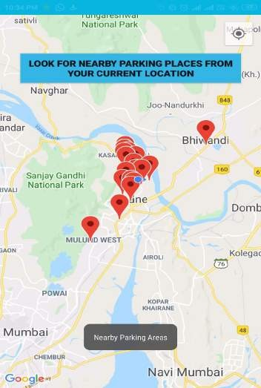
Module-6(Nearby Parking Areas)
The nearby parking area feature is provided in our application so that a user can book a slot in the nearby area if the main parking area fully occupied.
A map displaying all the nearby parking areas is shown in the application and the user is able book a slot in the nearest parking area.

Slide 27
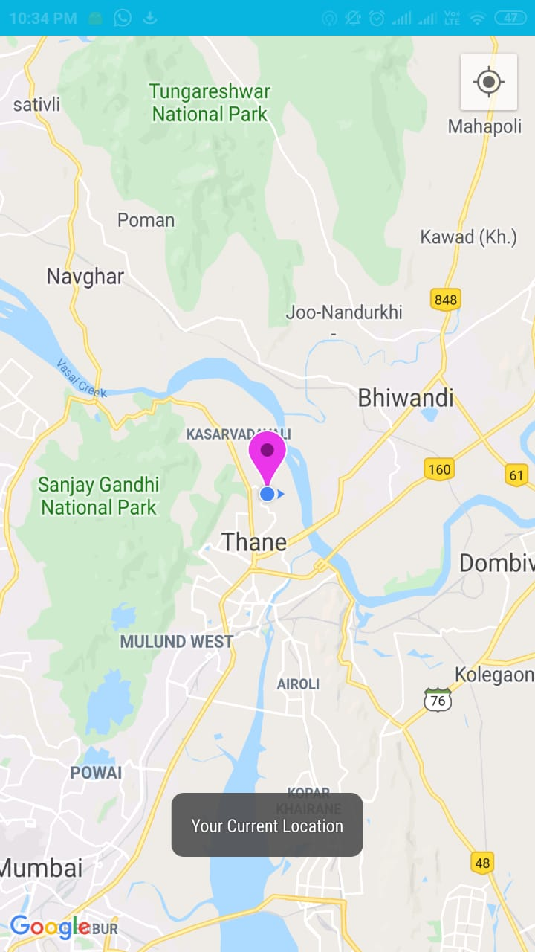
Module-6(Nearest Parking Area)
The nearest parking area is that which is the closest to the main parking area which can prove to be an alternative for the main area in case it is full.
The nearest parking area in our case is the area right outside the college premises (i.e. Veg Sizzles).
The user can book a slot in the nearest area using this application.

Slide 28
2.7 References
[1] D.Vakula and Yeshwanth Krishna Kolli, “Low Cost Smart Parking System for Smart Cities”, Department of Electronics and Communication Engineering National Institute of Technology, Warangal Telangana, India.
[2] Chaudhary, H., Bansal, P., & Valarmathi, B. “Advanced CAR parking system using Arduino”. 2017 4th International Conference on Advanced Computing and Communication Systems (ICACCS).
[3] Mendiratta, S., Dey, D., & Rani Sona, D. (2017). “Automatic car parking system with visual indicator along with IoT”. 2017 International Conference on Microelectronic Devices, Circuits and Systems.
[4] Desai, J., Bhanje, A., Biradar, S., & Fernandes, D “IoT based Vehicle Parking Manager.” 2017 7th International Conference on Cloud Computing, Data Science, Engineering Confluence.
[5] Khanna, A., & Anand, R. (2016). IoT based smart parking system. 2016 International Conference on Internet of Things and Applications (IOTA).
[6] Owayjan, M., Sleem, B., Saad, E., & Maroun, A. (2017). Parking management system using mobile application. 2017 Sensors Networks Smart and Emerging Technologies (SENSET).
[7] Devi, R. S. S., Kumar, V. R. V., & Sridevi, S. (2017). Application development for reservation based parking slot allotment and management system using Android. 2017 International Conference on Innovations in Information, Embedded and Communication Systems (ICIIECS).
[8] Praveen, M., & Harini, V. (2019). NB-IOT based smart car parking system. 2019 International Conference on Smart Structures and Systems (ICSSS).
[9] Lee, C., Han, Y., Jeon, S., Seo, D., & Jung, I. (2016). Smart parking system for Internet of Things. 2016 IEEE International Conference on Consumer Electronics (ICCE).
[10] Hakim, I. M., Christover, D., & Jaya Marindra, A.M. (2019). Implementation of an Image Processing based Smart Parking System using Haar-Cascade Method. 2019 IEEE 9th Symposium on Computer Applications & Industrial Electronics (ISCAIE)

Slide 29
3. Conclusion and Future Scope

Slide 30
Conclusion
By implementing this system, we are making the work of finding parking slots for private vehicles much more easier. The interface provided by the system would be user friendly and interactive which will attract more customer base. This thereby will solve the problem of traffic jams causing inconvenience to the people on road. Finding parking slots will no more be a difficult task for the vehicle owners. Availability of these parking areas will be known before hand. A proper bill and amount calculation based on the time for which the vehicle was parked is provided to the customers using this system.
Future Scope
Our application can be scaled up for further use by residential societies.
It can also be used at bigger parking areas for eg. Malls, Airports, etc.

Slide 31
Thank You

